Slide 1
Figures from Curbing Catastrophe
(Chapter Eight)
Timothy H Dixon
University of South Florida
Tampa

Slide 2
Notes:
Figure 8.1 The Mauna Loa data from Charles Keeling’s 1960 paper, showing annual variation of atmospheric CO₂ concentration (in parts per million, ppm) from plant growth in the Northern Hemisphere. The sampling (almost monthly) captures the annual signal (compare to Figure A.3.1). Although Keeling postulated that CO₂ was increasing (based on limited additional data from Antarctica), longer-term observations would be needed before the increasing trend became apparent.

Slide 3
Notes:
Figure 8.2. The Keeling curve shows CO₂concentration in the atmosphere as a function of time. The small wiggles show the yearly fluctuation associated with Northern Hemisphere “greening” that begins in the spring (which takes up CO₂) and ending in the fall (which releases CO₂), first shown by Keeling (Figure 8.1). The longer time span of this figure compared to Figure 8.1 clearly shows the trend of rising CO₂. The rate of rise is also increasing. When Keeling began his measurements, concentrations were rising at about 1.3 ppm (parts per million) per year. Now they are rising at 2 ppm per yr. Pre-industrial CO₂ levels are believed to be about 260-280 ppm. In 2013, we briefly hit 400 ppm (white horizontal line) for the first time in several hundred thousand years. We now routinely exceed this value. Figure by Theresa Maye, using data from Scripps Institution of Oceanography (http://scrippsco2.ucsd.edu/).

Slide 4
Notes:
Figure 8.3. “Ice-off” dates on the Tanana River, Alaska, as a function of year, awarded in the Nenana Ice Classic contest, held every year since 1917. The best fit line through the data is also shown, and shows a small (~10 day) change over this period.

Slide 5
Notes:
Figure 8.4. Global average surface temperature over land areas for the last 250 years, compiled by the Berkeley Earth Surface Temperature project.

Slide 6
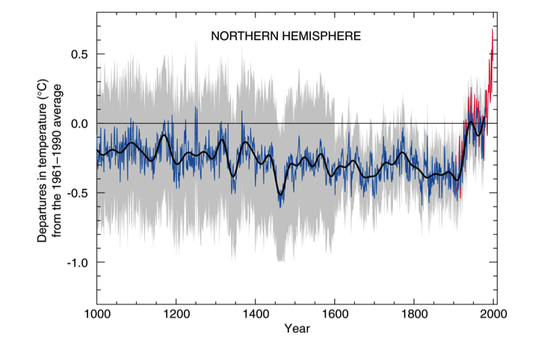
Notes:
Figure 8.5. A “hockey stick” plot showing surface temperatures in the Northern Hemisphere for the last 1000 years. Grey band shows amount of uncertainty. Data for last ~150 years come from direct temperature measurements such as those in Figure 8.4, with less uncertainty, while earlier data are estimates based on studies of corals, tree rings, ice cores, and other proxy records, and have more uncertainty. A period of overlap for some of the proxies with modern temperature measurements allows calibration. Mann et al. [2008] provide updated and more detailed versions of these data. Source: IPCC (Intergovernmental Panel on Climate Change).

Slide 7
Notes:
Figure 8.6a. Histogram of 31 hypothetical average daily temperature measurements taken over one summer month.

Slide 8
Notes:
Figure 8.6b. Hypothetical histogram of daily summer temperatures for a mid-latitude region, averaged over two separate decades. The more recent decade is warmer, increasing the chance of summer heat waves.

Slide 9
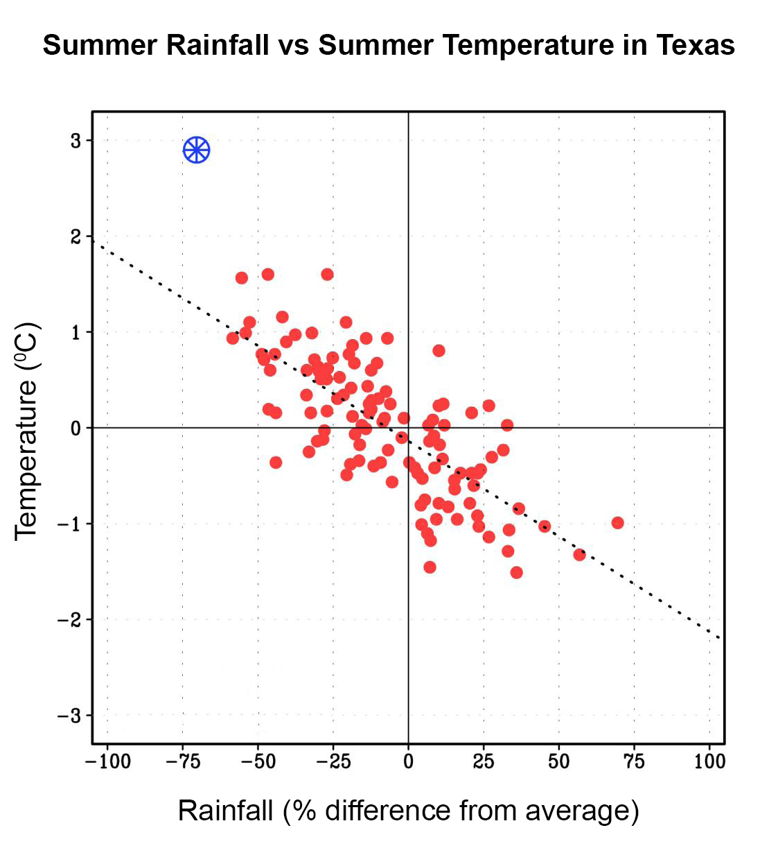
Notes:
Figure 8.7. Average summer temperature in Texas (vertical axis) defined by June-August temperature anomaly, or difference from average, compared to rainfall (horizontal axis) for every year between 1895 – 2010 (small circles). The anomalous 2011 summer event is shown by the “wagon wheel” on the upper left. The dotted line is the best fit line through the data, and emphasizes that hotter summers tend to have less rainfall. Modified from Hoerling et al. (2013).

Slide 10
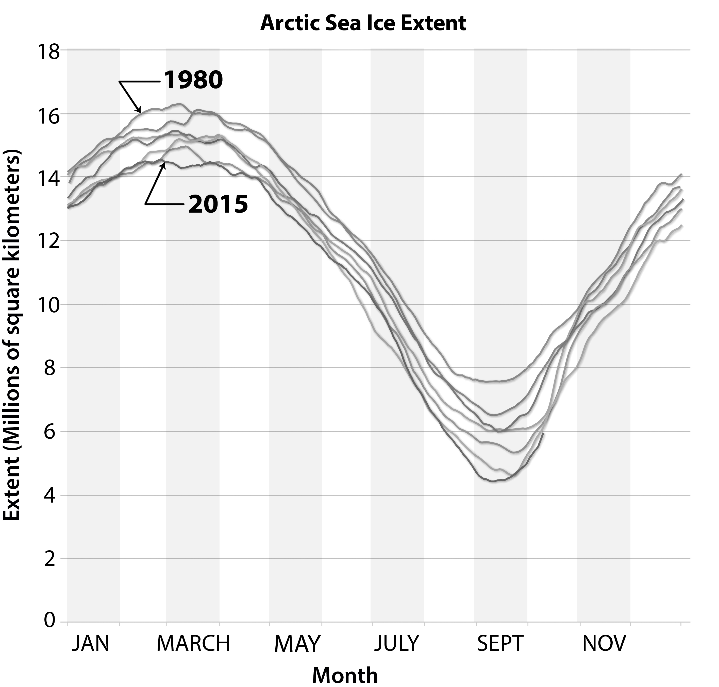
Notes:
Figure 8.8a. Arctic sea ice extent (areas with at least 15% ice cover) plotted every 5 years since 1980. The maximum occurs in late February or March, at the end of winter, while the minimum occurs in September, at the end of summer. Data courtesy of National Snow and Ice Data Center (NSIDC).

Slide 11
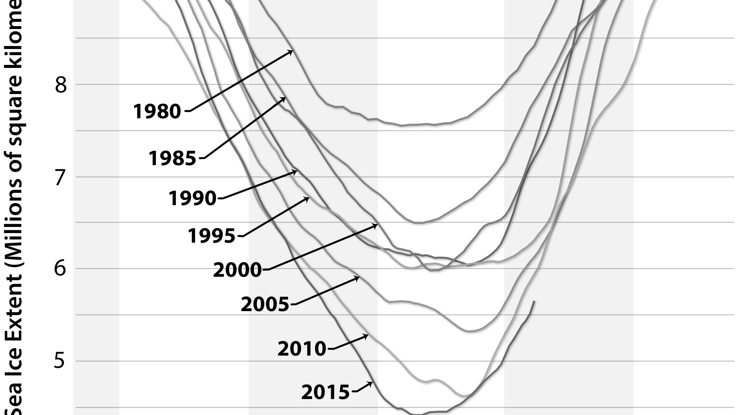
Notes:
Figure 8.8b. Similar to Figure 8.8a, but zoomed in to show sea ice extent in the summer. By summer 2015, sea ice extent was about two thirds of the summer 1980 value.

Slide 12
Notes:
Figure 8.8c. Arctic sea ice area as a function of time. The data (black line) show the summer minimum ice area for each year, and are fit with two straight lines (grey lines). The later one, from 1996 to 2014, shows summer sea ice decreasing faster than the previous two decades. If this trend continues, the Arctic will be ice free in summer by 2050 or earlier. Modified from Yang et al. (2016).

Slide 13
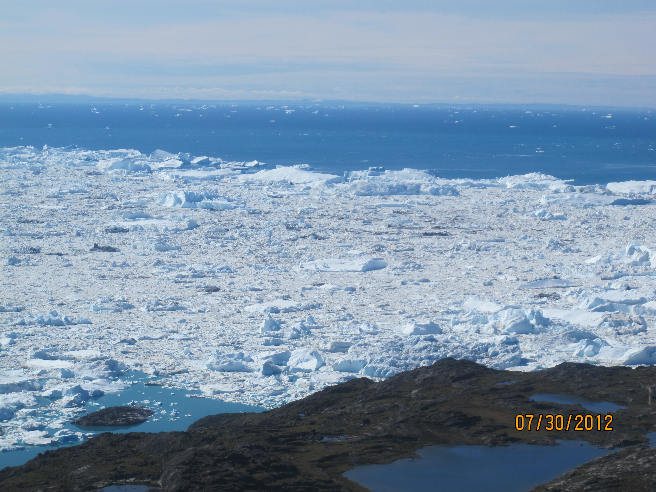
Notes:
Figure 8.9. The edge of the iceberg mélange near Illulisat, Greenland, probably marking the underwater location of an end-moraine, a ridge of gravel and rock representing the glaciers’ farthest advance thousands of years ago.

Slide 14
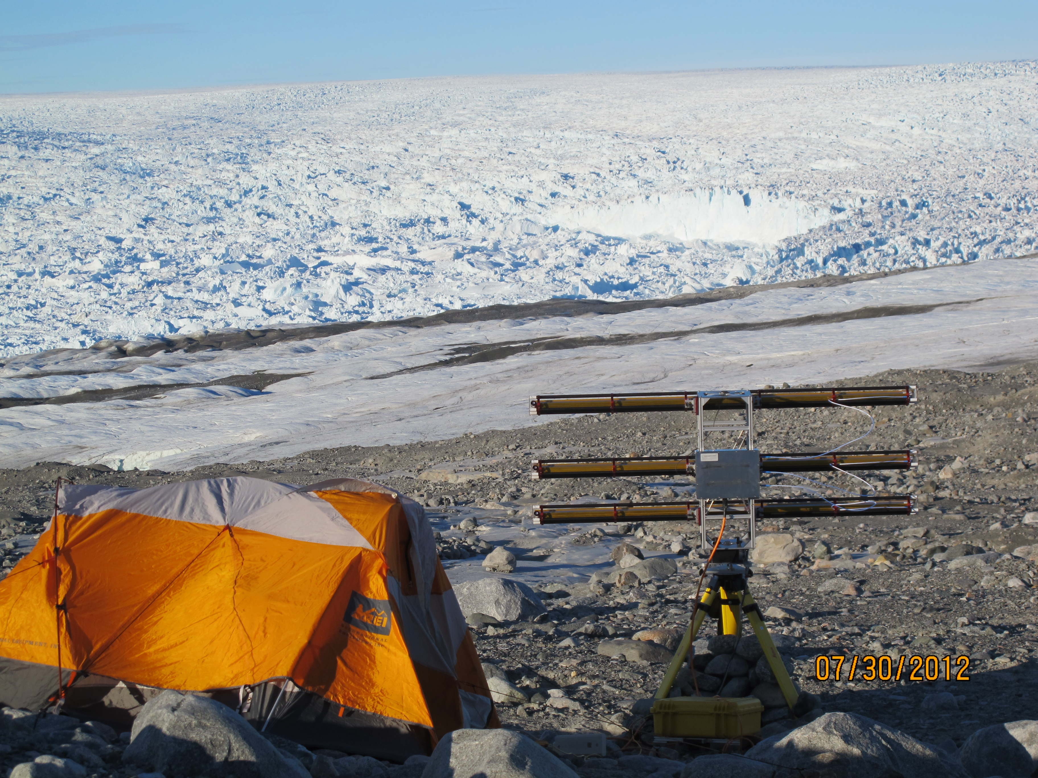
Notes:
Figure 8.10a. The calving front at Jakobshavn Isbrae during summer, 2012. An instrument for measuring ice velocity is visible in the foreground, along with a small tent to shelter the operators (the author and graduate student Denis Voytenko) from the wind. The curved ice front is approximately 150 meters high, and its center is 5 km away, near the upper right hand side of this photo. The Greenland ice sheet is in the background and to the right of the ice front. Jakobshavn’s ice-filled fjord is at the center-left, below the front. Ice motion is from right to left. Photo by the author.

Slide 15
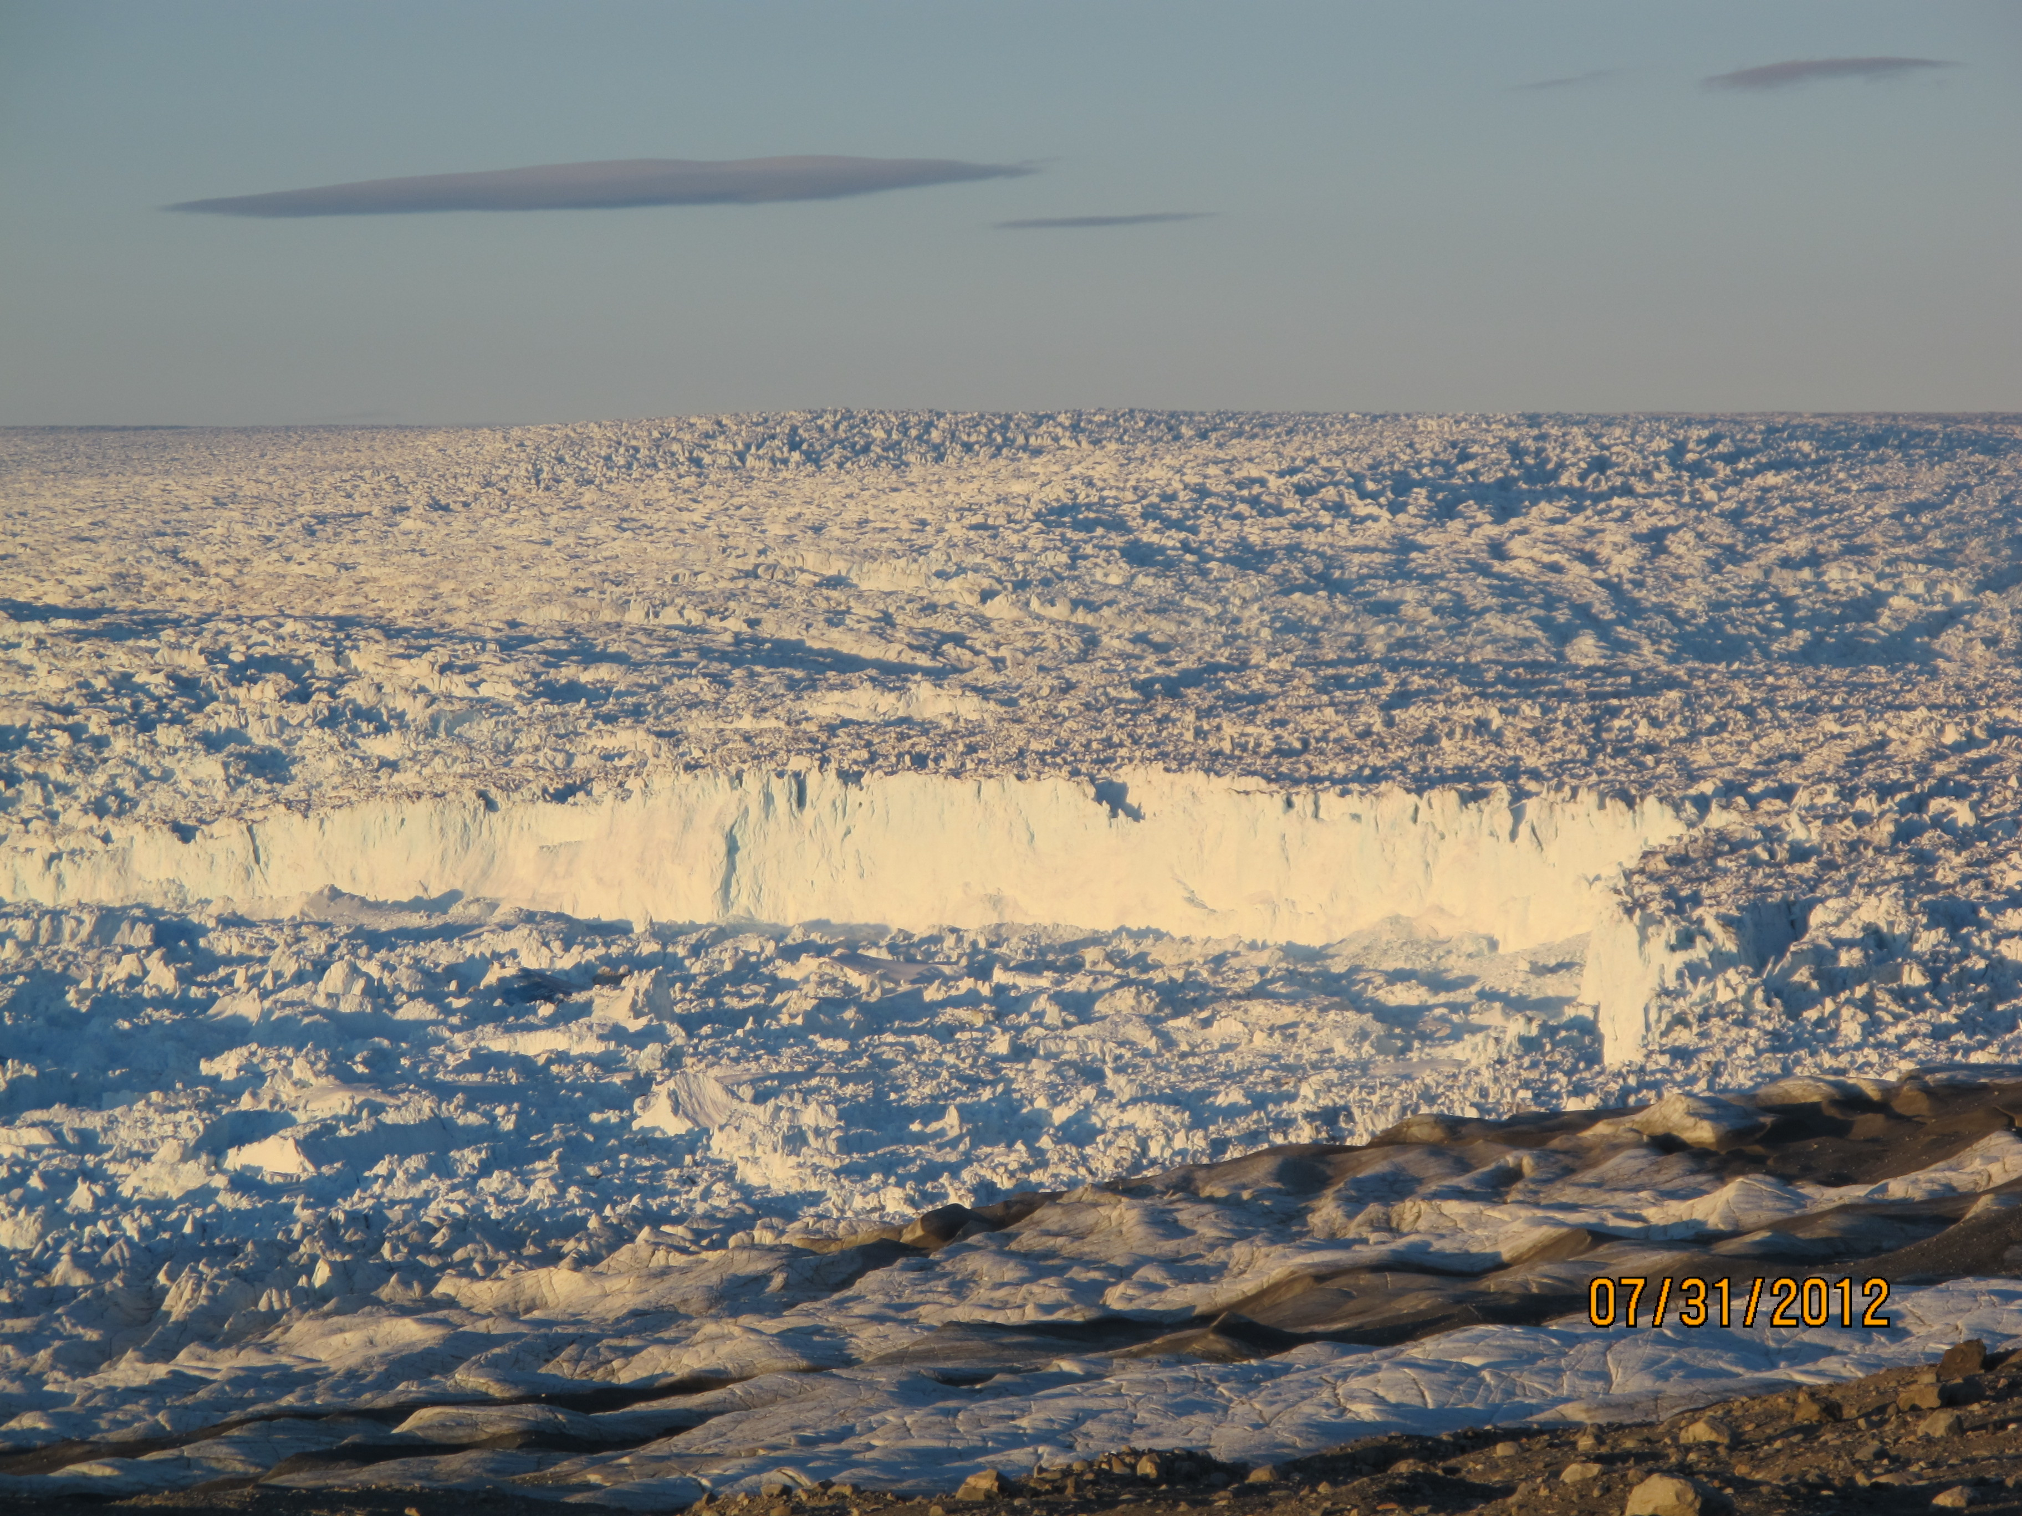
Notes:
8.10b. A close-up of the calving front, taken near local midnight. The boundary (calving front) between the higher elevation glacier (right hand side) and lower elevation ice-chocked fjord (left hand side) is more apparent when the sun is low on the horizon.

Slide 16
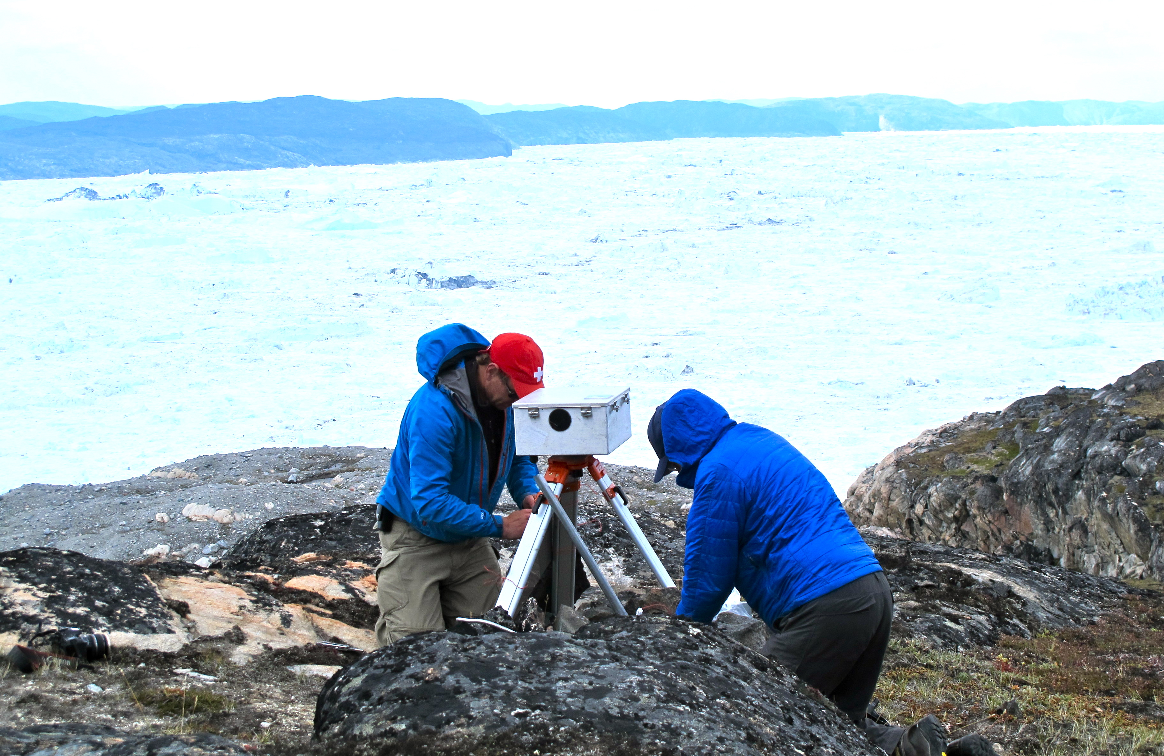
Notes:
Figure 8.11. Scientists from the University of Alaska work on a time-lapse camera that records motion of the ice mélange in Jakobshavn’s ice-filled fjord (background). At this location, the fjord is about 8 km wide. Photo by the author.

Slide 17
Notes:
Figure 8.12. Plots of temperature versus time (e.g., Figures 8.4 and 8.5) don’t tell the whole story when it comes to climate change and the planet’s ecosystems. It has been much warmer in the past, unrelated to human activity. What is unique about modern warming is how fast it is happening – much faster than previous warming episodes, and too fast for many species to adapt. This figure shows how fast global temperature is changing (vertical axis) versus time. Note the very low rates of change until the last ~ 1000 years. The apparent variability beginning about then may simply reflect more detailed information in the more recent period, but could also reflect the beginnings of human influence on climate, when deforestation and agriculture were becoming widespread [Ruddiman, 2013]. More importantly, the modern era (last ~150 years) is clearly anomalous. Based on data from Marcott et al. [2013], calculated by taking the first derivative of their global temperature versus time data set.

Slide 18
Notes:
Figure 8.13. Human population over the last 12,000 years. The brief “dip” in population growth around 400-800 AD (1200 – 1600 years before present) and uneven growth in the next few centuries may represent the influence of the Justinian and later plagues, when Black Death (possibly bubonic plague) first began to devastate Europe and Asia. Data sources: United Nations; US Census Bureau.

